Slide 1
Unit 5
Sequence Modelling – Recurrent and Recursive Nets

Slide 2
Sequence Modelling
Sequence modeling is a task of modeling sequential data. Modeling sequence data is when you create a mathematical notion to understand and study sequential data, and use those understandings to generate, predict or classify the same for a specific application.
Sequential data has three properties:
Elements in the sequence can repeat
It follows order (contextual arrangement)
Length of data varies (potentially infinitely)
Example of sequential data are:
Text and sentences, Audio (eg. speech and music), Motion pictures or videos, Time-series data (eg. Stock market data), DNA sequence, protein structures ,Material composition , Decision-making

Slide 3
Sequence data is difficult to model because of its properties, and it requires a different method. For instance, if sequential data is fed through a feed-forward network, it might not be able to model it well, because sequential data has variable length.
The feed-forward network works well with fixed-size input, and doesn’t take structure into account well.
Convolutional neural networks, on the other hand, were created to process structures, or grids of data, such as an image.
They can deal with long sequences of data, but are limited by the fact that they can’t order the sequence correctly.

Slide 4
Recurrent Neural Network
Recurrent neural networks are used to model sequential data with the time step index t, and incorporate the technique of context vectorizing.
Recurrent Neural Network(RNN) is a type of Neural Network where the output from the previous step is fed as input to the current step.
In traditional neural networks, all the inputs and outputs are independent of each other. Still, in cases when it is required to predict the next word of a sentence, the previous words are required and hence there is a need to remember the previous words.
Thus RNN came into existence, which solved this issue with the help of a Hidden Layer.
The main and most important feature of RNN is its Hidden state, which remembers some information about a sequence.
The state is also referred to as Memory State since it remembers the previous input to the network. It uses the same parameters for each input as it performs the same task on all the inputs or hidden layers to produce the output. This reduces the complexity of parameters, unlike other neural networks.

Slide 5
Like many other deep learning algorithms, recurrent neural networks are relatively old. They were initially created in the 1980s, but only in recent years have we seen their true potential. An increase in computational power along with the massive amounts of data that we now have to work with, and the invention of long short-term memory (LSTM) in the 1990s, has really brought RNNs to the foreground.
Because of their internal memory, RNNs can remember important things about the input they received, which allows them to be very precise in predicting what’s coming next.
This is why they’re the preferred algorithm for sequential data like time series, speech, text, financial data, audio, video, weather and much more. Recurrent neural networks can form a much deeper understanding of a sequence and its context compared to other algorithms.
Since RNNs are being used in the software behind Siri and Google Translate, recurrent neural networks show up a lot in everyday life.

Slide 6
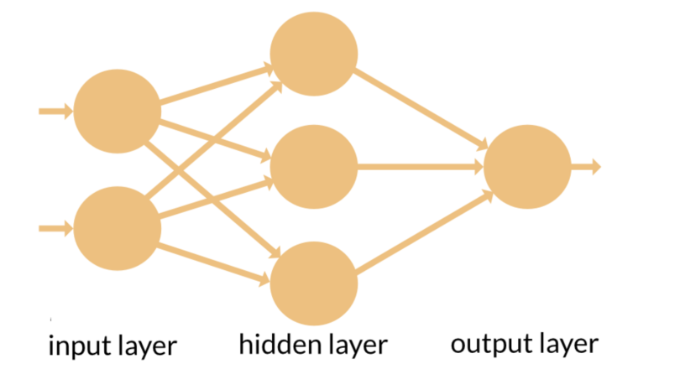
How Do Recurrent Neural Networks Work?
Sequential data is basically just ordered data in which related things follow each other. Examples are financial data or the DNA sequence. The most popular type of sequential data is perhaps time series data, which is just a series of data points that are listed in time order.

Slide 7
RNNs and feed-forward neural networks get their names from the way they channel information.
In a feed-forward neural network, the information only moves in one direction — from the input layer, through the hidden layers, to the output layer. The information moves straight through the network.
Feed-forward neural networks have no memory of the input they receive and are bad at predicting what’s coming next. Because a feed-forward network only considers the current input, it has no notion of order in time. It simply can’t remember anything about what happened in the past except its training.
In an RNN, the information cycles through a loop. When it makes a decision, it considers the current input and also what it has learned from the inputs it received previously.

Slide 8
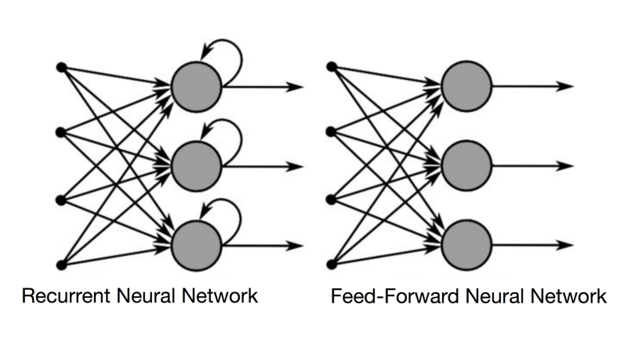

Slide 9
A usual RNN has a short-term memory. In combination with an LSTM they also have a long-term memory .
Another good way to illustrate the concept of a recurrent neural network’s memory is to explain it with an example: Imagine you have a normal feed-forward neural network and give it the word “neuron” as an input and it processes the word character by character. By the time it reaches the character “r,” it has already forgotten about “n,” “e” and “u,” which makes it almost impossible for this type of neural network to predict which character would come next.
A recurrent neural network, however, is able to remember those characters because of its internal memory. It produces output, copies that output and loops it back into the network.

Slide 10
Therefore, an RNN has two inputs: the present and the recent past. This is important because the sequence of data contains crucial information about what is coming next, which is why an RNN can do things other algorithms can’t.
A feed-forward neural network assigns, like all other deep learning algorithms, a weight matrix to its inputs and then produces the output.
Note that RNNs apply weights to the current and also to the previous input. Furthermore, a recurrent neural network will also tweak the weights for both gradient descent and backpropagation through time.

Slide 11
Types of Recurrent Neural Networks
One to One
One to Many
Many to One
Many to Many

Slide 12
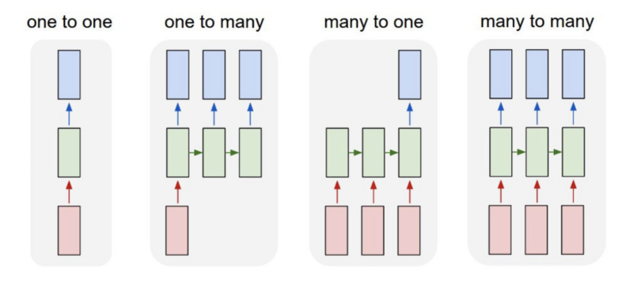

Slide 13
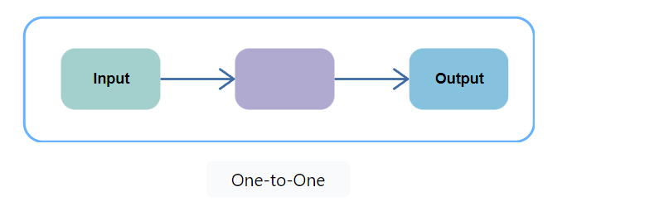
1. One-to-One
The simplest type of RNN is One-to-One, which allows a single input and a single output. It has fixed input and output sizes and acts as a traditional neural network. The One-to-One application can be found in Image Classification.

Slide 14
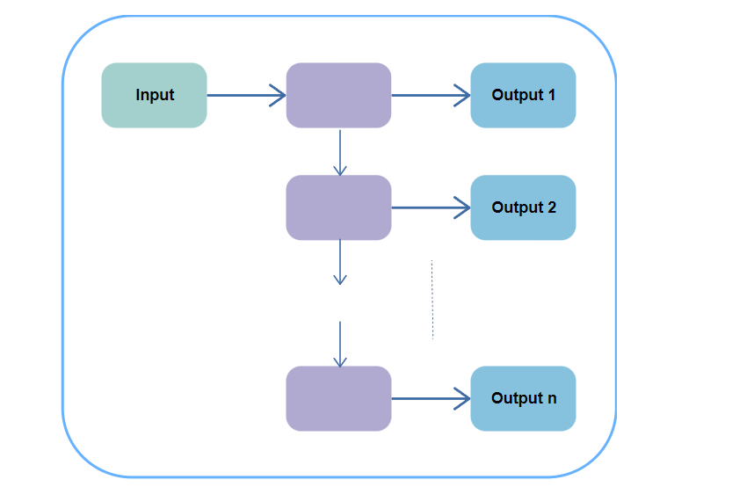
2. One-to-Many
One-to-Many is a type of RNN that gives multiple outputs when given a single input. It takes a fixed input size and gives a sequence of data outputs. Its applications can be found in Music Generation and Image Captioning.

Slide 15
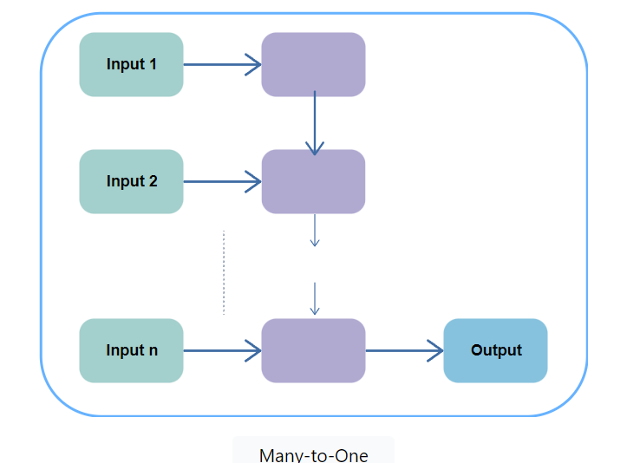
3. Many-to-One
Many-to-One is used when a single output is required from multiple input units or a ﻿sequence of them. It takes a sequence of inputs to display a fixed output. Sentiment Analysis is a common example of this type of Recurrent Neural Network.

Slide 16
4. Many-to-Many
Many-to-Many is used to generate a sequence of output data from a sequence of input units.
This type of RNN is further divided into ﻿the following two subcategories:
1. Equal Unit Size: In this case, the number of both the input and output units is the same. A common application can be found in Name-Entity Recognition.
2. Unequal Unit Size: In this case, inputs and outputs have different numbers of units. Its application can be found in Machine Translation.

Slide 17
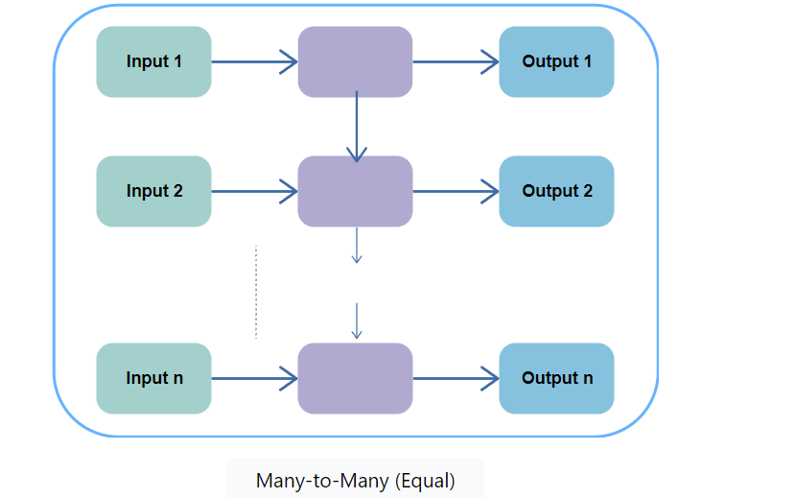
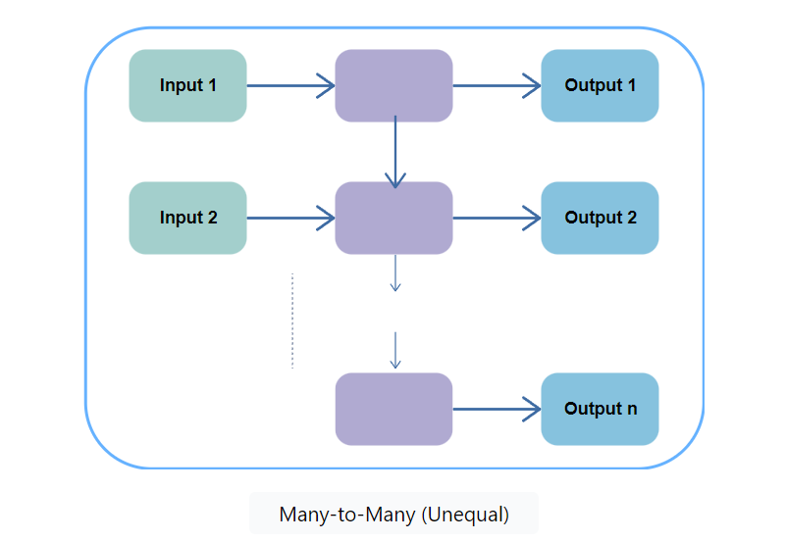

Slide 18
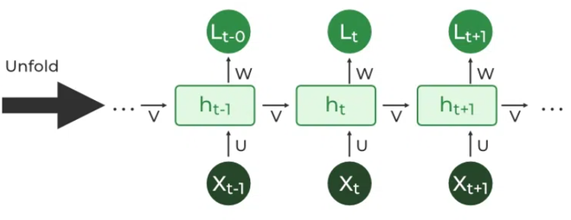
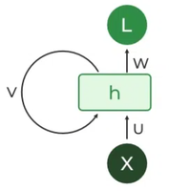
Recurrent Neuron and RNN Unfolding
The fundamental processing unit in a Recurrent Neural Network (RNN) is a Recurrent Unit, which is not explicitly called a “Recurrent Neuron.”
This unit has the unique ability to maintain a hidden state, allowing the network to capture sequential dependencies by remembering previous inputs while processing.
Long Short-Term Memory (LSTM) and Gated Recurrent Unit (GRU) versions improve the RNN’s ability to handle long-term dependencies.

Slide 19
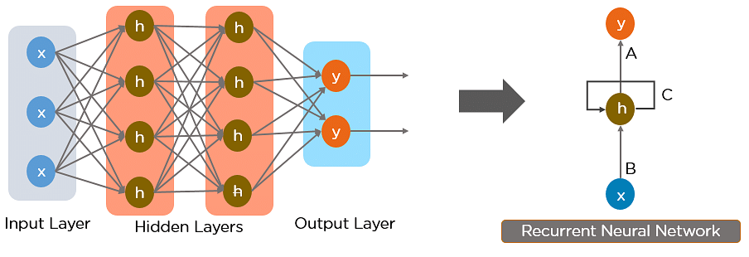

Slide 20
RNN Architecture
RNNs are a type of neural network that has hidden states and allows past outputs to be used as inputs. They usually go like this:
Here’s a breakdown of its key components:
Input Layer: This layer receives the initial element of the sequence data. For example, in a sentence, it might receive the first word as a vector representation.
Hidden Layer: The heart of the RNN, the hidden layer contains a set of interconnected neurons. Each neuron processes the current input along with the information from the previous hidden layer’s state. This “state” captures the network’s memory of past inputs, allowing it to understand the current element in context.
Activation Function: This function introduces non-linearity into the network, enabling it to learn complex patterns. It transforms the combined input from the current input layer and the previous hidden layer state before passing it on.

Slide 21
Output Layer: The output layer generates the network’s prediction based on the processed information. In a language model, it might predict the next word in the sequence.
Recurrent Connection: A key distinction of RNNs is the recurrent connection within the hidden layer. This connection allows the network to pass the hidden state information (the network’s memory) to the next time step. It’s like passing a baton in a relay race, carrying information about previous inputs forward

Slide 22
RNNs have the same input and output architecture as any other deep neural architecture.
However, differences arise in the way information flows from input to output.
Unlike Deep neural networks where we have different weight matrices for each Dense network in RNN, the weight across the network remains the same. It calculates state hidden state Hi for every input Xi .

Slide 23
By using the following formulas:
h= σ(UX + Wh₋₁ + B)
Y = O(Vh + C)
Hence
Y = f (X, h , W, U, V, B, C)
Here S is the State matrix which has element si as the state of the network at timestep i
The parameters in the network are W, U, V, C,B which are shared across timestep

Slide 24
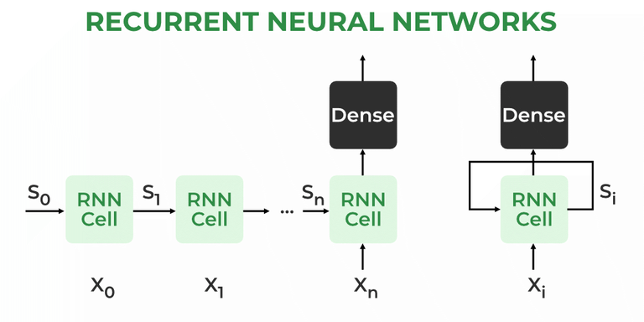

Slide 25
Working of RNN
The Recurrent Neural Network consists of multiple fixed activation function units, one for each time step.
Each unit has an internal state which is called the hidden state of the unit. This hidden state signifies the past knowledge that the network currently holds at a given time step.
This hidden state is updated at every time step to signify the change in the knowledge of the network about the past.

Slide 26
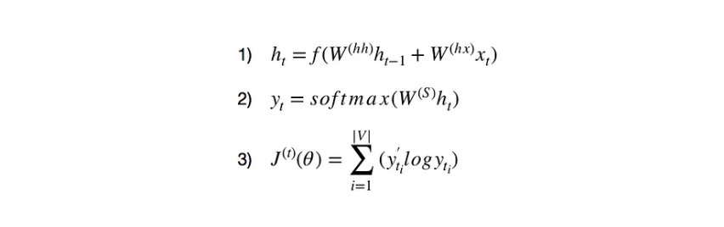

Slide 27
1) holds information about the previous words in the sequence. As you can see, h_t is calculated using the previous h_(t-1) vector and current word vector x_t. We also apply a non-linear activation function f (usually tanh or sigmoid) to the final summation. It is acceptable to assume that h_0 is a vector of zeros.
2) calculates the predicted word vector at a given time step t. We use the SoftMax function to produce a (V,1) vector with all elements summing up to 1. This probability distribution gives us the index of the most likely next word from the vocabulary.
3)uses the cross-entropy loss function at each time step t to calculate the error between the predicted and actual word.

Slide 28
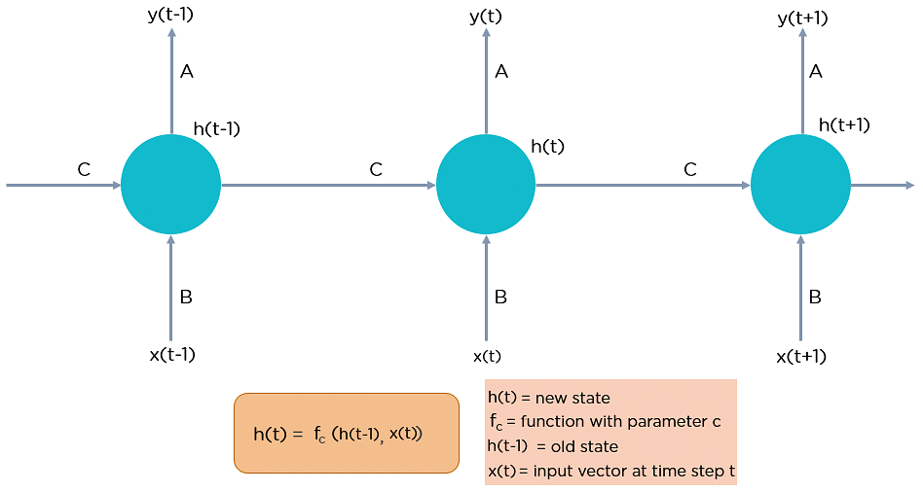

Slide 29
Example:
First, we need to train the network using a large dataset. For the purpose, we can choose any large text .When done training, we can input the sentence “Napoleon was the Emperor of…” and expect a reasonable prediction based on the knowledge from the book.
we input one example at a time and produce one result, both of which are single words.
The difference with a feedforward network comes in the fact that we also need to be informed about the previous inputs before evaluating the result.
So you can view RNNs as multiple feedforward neural networks, passing information from one to the other.

Slide 30
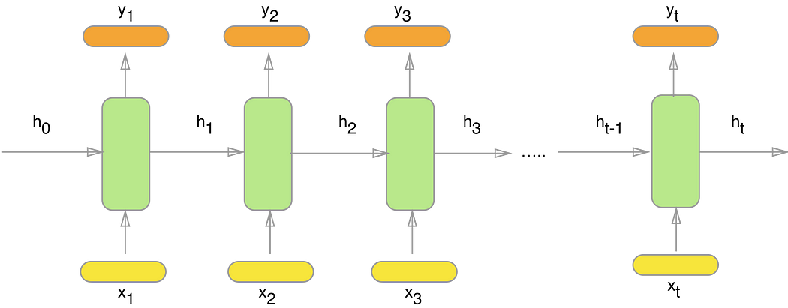

Slide 31
Here x_1, x_2, x_3, …, x_t represent the input words from the text, y_1, y_2, y_3, …, y_t represent the predicted next words and h_0, h_1, h_2, h_3, …, h_t hold the information for the previous input words.
Since plain text cannot be used in a neural network, we need to encode the words into vectors.
The best approach is to use word embeddings (word2vec or GloVe). For example, if our vocabulary is apple, apricot, banana, …, king, … zebra and the word is banana, then the vector is [0, 0, 1, …, 0, …, 0].

Slide 32
If you are wondering what these W’s are, each of them represents the weights of the network at a certain stage.
As mentioned above, the weights are matrices initialized with random elements, adjusted using the error from the loss function.
We do this adjusting using back-propagation algorithm which updates the weights.
Once we have obtained the correct weights, predicting the next word in the sentence “Napoleon was the Emperor of…” is quite straightforward. Plugging each word at a different time step of the RNN would produce h_1, h_2, h_3, h_4. We can derive y_5 using h_4 and x_5 (vector of the word “of”).
If our training was successful, we should expect that the index of the largest number in y_5 is the same as the index of the word “France” in our vocabulary.

Slide 33
Steps of RNN
1.Sequence Input:
RNNs take a sequence of inputs as their primary data format. Each element in the sequence corresponds to a time step, and the goal is to process the sequence step by step to learn patterns and relationships.
2. Hidden State:
At each time step, an RNN maintains a hidden state vector, which captures information about the current input and the previous hidden state. This hidden state serves as the memory of the network and allows it to maintain context from earlier time steps.

Slide 34
3. Input and Hidden State Interaction:
The input at each time step is combined with the previous hidden state to produce a new hidden state. This combination involves matrix multiplication and activation functions, often a hyperbolic tangent (tanh) or rectified linear unit (ReLU).
4. Updating Hidden State
5.Sequence Processing:
The RNN processes the entire sequence by iteratively updating the hidden state for each time step. As it progresses through the sequence, the hidden state accumulates information about the previous inputs and hidden states.

Slide 35
6. Output Generation:
Depending on the task, an RNN can produce an output at each time step or only at the final time step. For example, in language modeling, an output might be generated at each step to predict the next word, whereas in sequence classification, the final hidden state might be used to produce the final prediction.
7. Backpropagation Through Time (BPTT):
To train an RNN, the process of backpropagation is extended through time. Errors are propagated backward from the output predictions to the initial time step, updating the weights to minimize the difference between predicted and actual values.

Slide 36
Backpropagation Through Time (BPTT)
Recurrent Neural Networks are those networks that deal with sequential data.
They predict outputs using not only the current inputs but also by taking into consideration those that occurred before it.
In other words, the current output depends on current output as well as a memory element (which takes into account the past inputs).
For training such networks, we use good old backpropagation but with a slight twist. We don’t independently train the system at a specific time “t”. We train it at a specific time “t” as well as all that has happened before time “t” like t-1, t-2, t-3

Slide 37
In a traditional feedforward neural network, the data flows through the network in one direction, from the input layer through the hidden layers to the output layer.
However, in RNNs, there are connections between nodes in different time steps, which means that the output of the network at one time step depends on the input at that time step as well as the previous time steps.
BPTT works by unfolding the RNN over time, creating a series of interconnected feedforward networks. Each time step corresponds to one layer in this unfolded network, and the weights between layers are shared across time steps. The unfolded network can be thought of as a very deep feedforward network, where the weights are shared across layers.
During training, the error is backpropagated through the unfolded network, and the weights are updated using gradient descent. This allows the network to learn to predict the output at each time step based on the input at that time step as well as the previous time steps.

Slide 38
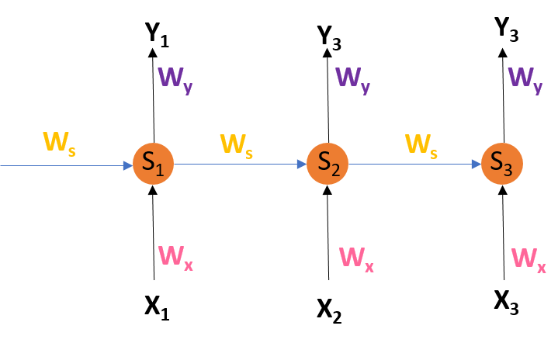

Slide 39
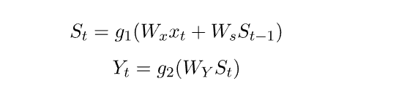
S1, S2, S3 are the hidden states or memory units at time t1, t2, t3 respectively, and Ws is the weight matrix associated with it.
X1, X2, X3 are the inputs at time t1, t2, t3 respectively, and Wx is the weight matrix associated with it.
Y1, Y2, Y3 are the outputs at time t1, t2, t3 respectively, and Wy is the weight matrix associated with it. For any time, t, we have the following two equations:

Slide 40
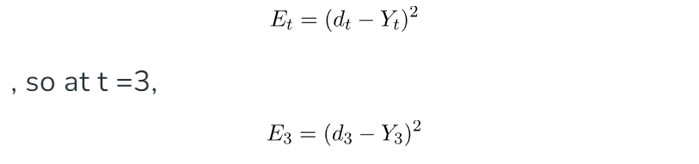
where g1 and g2 are activation functions.
Let us now perform back propagation at time t = 3. Let the error function be:

Slide 41
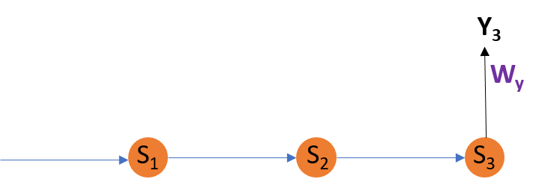
Adjusting Wy
We are using the squared error here, where d3 is the desired output at time t = 3.
To perform back propagation, we have to adjust the weights associated with inputs, the memory units and the outputs. Adjusting Wy For better understanding.

Slide 42
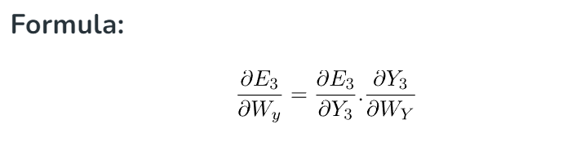
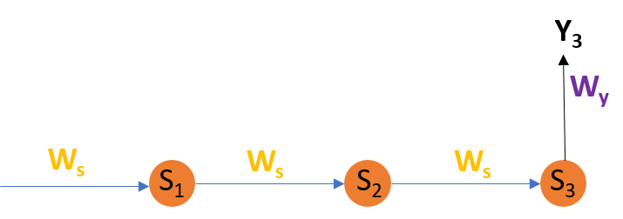
Explanation: E3 is a function of Y3. Hence, we differentiate E3 w.r.t Y3. Y3 is a function of WY. Hence, we differentiate Y3 w.r.t WY. Adjusting Ws For better understanding

Slide 43
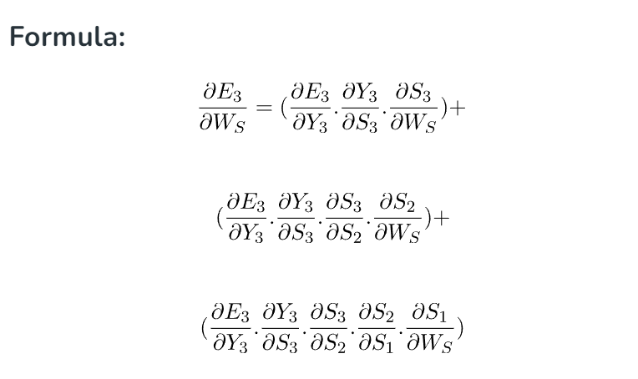
Adjusting Ws
Explanation: E3 is a function of Y3. Hence, we differentiate E3 w.r.t Y3. Y3 is a function of S3. Hence, we differentiate Y3 w.r.t S3. S3 is a function of WS. Hence, we differentiate S3 w.r.t WS. But we can’t stop with this; we also have to take into consideration, the previous time steps. So, we differentiate (partially) the Error function with respect to memory units S2 as well as S1 taking into consideration the weight matrix WS. We have to keep in mind that a memory unit, say S_{t} is a function of its previous memory unit S_{t-1}. Hence, we differentiate S3 with S2 and S2 with S1.

Slide 44
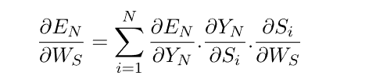
Generally, we can express this formula as:

Slide 45
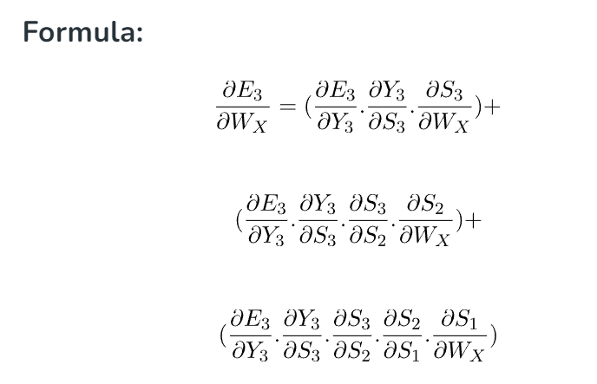
Adjusting WX
Explanation: E3 is a function of Y3. Hence, we differentiate E3 w.r.t Y3. Y3 is a function of S3. Hence, we differentiate Y3 w.r.t S3. S3 is a function of WX. Hence, we differentiate S3 w.r.t WX. Again we can’t stop with this; we also have to take into consideration, the previous time steps. So, we differentiate (partially) the Error function with respect to memory units S2 as well as S1 taking into consideration the weight matrix WX

Slide 46
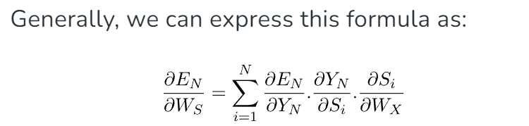
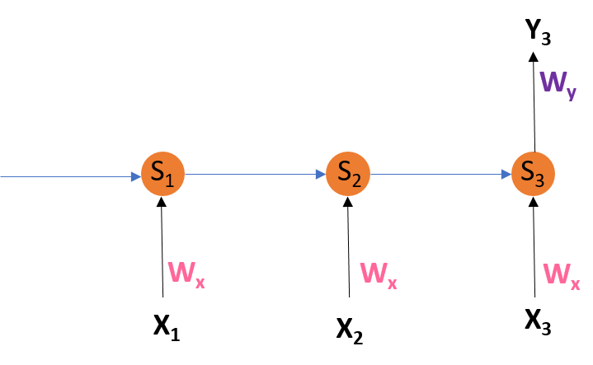

Slide 47
Limitations of BPTT
This technique that uses the back Propagation over time (BPTT) is a method that can be employed for a limited amount of time intervals, like 8 or 10.
If we continue to backpropagate and the gradient gets too small. This is known as the "Vanishing gradient" problem.
This is because the value of information diminishes geometrically with time. Therefore, if the number of time steps is greater than 10 (Let's say), the data is effectively discarded.

Slide 48
Going Beyond RNNs:
One of the most famous solutions to this issue is using what's known as Long-Short-Term Memory (LSTM for short) cells instead of conventional RNN cells. However, there could be another issue, referred to as the explosion gradient problem, in which the gradient becomes uncontrollably high.
Solution:
A well-known method is known as gradient clipping when for each time step, we will determine if the gradient δ is greater than the threshold. If it is, then we should normalize it.

Slide 49
Bi-directional Recurrent Neural Network
Bi-directional recurrent neural networks (Bi-RNNs) are artificial neural networks that process input data in both the forward and backward directions.
They are often used in natural language processing tasks, such as language translation, text classification, and named entity recognition.
In addition, they can capture contextual dependencies in the input data by considering past and future contexts.
Bi-RNNs consist of two separate RNNs that process the input data in opposite directions, and the outputs of these RNNs are combined to produce the final output.

Slide 50
The goal of a Bi-RNN is to capture the contextual dependencies in the input data by processing it in both directions, which can be useful in various natural language processing (NLP) tasks.
One common way to combine the outputs of the forward and reverse RNNs is to concatenate them. Still, other methods, such as element-wise addition or multiplication, can also be used. The choice of combination method can depend on the specific task and the desired properties of the final output.

Slide 51
The BRNN functions similarly to conventional recurrent neural networks in the forward direction, updating the hidden state depending on the current input and the prior hidden state at each time step.
The backward hidden layer, on the other hand, analyses the input sequence in the opposite manner, updating the hidden state based on the current input and the hidden state of the next time step.
Compared to conventional unidirectional recurrent neural networks, the accuracy of the BRNN is improved since it can process information in both directions and account for both past and future contexts.
Because the two hidden layers can complement one another and give the final prediction layer more data, using two distinct hidden layers also offers a type of model regularization.

Slide 52
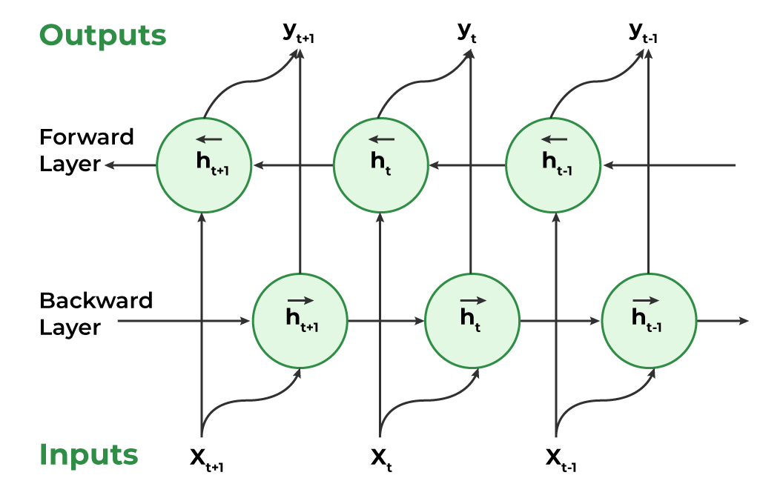
In order to update the model parameters, the gradients are computed for both the forward and backward passes of the backpropagation through the time technique that is typically used to train BRNNs.
The input sequence is processed by the BRNN in a single forward pass at inference time, and predictions are made based on the combined outputs of the two hidden layers.

Slide 53
Working of Bidirectional Recurrent Neural Network
Inputting a sequence: A sequence of data points, each represented as a vector with the same dimensionality, are fed into a BRNN. The sequence might have different lengths.
Dual Processing: Both the forward and backward directions are used to process the data. On the basis of the input at that step and the hidden state at step t-1, the hidden state at time step t is determined in the forward direction. The input at step t and the hidden state at step t+1 are used to calculate the hidden state at step t in a reverse way.

Slide 54
Computing the hidden state: A non-linear activation function on the weighted sum of the input and previous hidden state is used to calculate the hidden state at each step. This creates a memory mechanism that enables the network to remember data from earlier steps in the process.
Determining the output: A non-linear activation function is used to determine the output at each step from the weighted sum of the hidden state and a number of output weights. This output has two options: it can be the final output or input for another layer in the network.

Slide 55
Training: The network is trained through a supervised learning approach where the goal is to minimize the discrepancy between the predicted output and the actual output. The network adjusts its weights in the input-to-hidden and hidden-to-output connections during training through backpropagation.

Slide 56
Applications of Bidirectional Recurrent Neural Network
Bi-RNNs have been applied to various natural language processing (NLP) tasks, including:
Sentiment Analysis: By taking into account both the prior and subsequent context, BRNNs can be utilized to categorize the sentiment of a particular sentence.
Named Entity Recognition: By considering the context both before and after the stated thing, BRNNs can be utilized to identify those entities in a sentence.
Part-of-Speech Tagging: The classification of words in a phrase into their corresponding parts of speech, such as nouns, verbs, adjectives, etc., can be done using BRNNs.

Slide 57
Machine Translation: BRNNs can be used in encoder-decoder models for machine translation, where the decoder creates the target sentence and the encoder analyses the source sentence in both directions to capture its context.
Speech Recognition: When the input voice signal is processed in both directions to capture the contextual information, BRNNs can be used in automatic speech recognition systems.

Slide 58
Advantages of Bidirectional RNN
Context from both past and future: With the ability to process sequential input both forward and backward, BRNNs provide a thorough grasp of the full context of a sequence. Because of this, BRNNs are effective at tasks like sentiment analysis and speech recognition.
Enhanced accuracy: BRNNs frequently yield more precise answers since they take both historical and upcoming data into account.
Efficient handling of variable-length sequences: When compared to conventional RNNs, which require padding to have a constant length, BRNNs are better equipped to handle variable-length sequences.

Slide 59
Resilience to noise and irrelevant information: BRNNs may be resistant to noise and irrelevant data that are present in the data. This is so because both the forward and backward paths offer useful information that supports the predictions made by the network.
Ability to handle sequential dependencies: BRNNs can capture long-term links between sequence pieces, making them extremely adept at handling complicated sequential dependencies.

Slide 60
Disadvantages of Bidirectional RNN
Computational complexity: Given that they analyze data both forward and backward, BRNNs can be computationally expensive due to the increased amount of calculations needed.
Long training time: BRNNs can also take a while to train because there are many parameters to optimize, especially when using huge datasets.
Difficulty in parallelization: Due to the requirement for sequential processing in both the forward and backward directions, BRNNs can be challenging to parallelize.

Slide 61
Overfitting: BRNNs are prone to overfitting since they include many parameters that might result in too complicated models, especially when trained on short datasets.
Interpretability: Due to the processing of data in both forward and backward directions, BRNNs can be tricky to interpret since it can be difficult to comprehend what the model is doing and how it is producing predictions.

Slide 62
Encoder-decoder sequence to sequence architectures
In Deep Learning, Many Complex problems can be solved by constructing better neural network architecture.
Seq2Seq model or Sequence-to-Sequence model, is a machine learning architecture designed for tasks involving sequential data.
The RNN(Recurrent Neural Network) and its variants are much useful in sequence to sequence learning. The RNN variant LSTM (Long Short-term Memory) is the most used cell in seq-seq learning tasks.
The encoder-decoder architecture for recurrent neural networks is the standard neural machine translation method that rivals and in some cases outperforms classical statistical machine translation methods.
This architecture is very new, having only been pioneered in 2014, although, has been adopted as the core technology inside Google’s translate service.

Slide 63
At the core of seq2seq models lies the attention mechanism, a game-changer that allows the decoder to focus dynamically on the most relevant parts of the input sequence.
This attention-based approach boosts accuracy and provides valuable insights into the model’s decision-making process. While classical seq2seq models faced hurdles with long sequences, the advent of transformers using self-attention has pushed the boundaries further.

Slide 64
Encoder-Decoder Model
The seq2seq models are encoder-decoder models.
The encoder processes the input sequence and transforms it into a fixed-size hidden representation.
The decoder uses the hidden representation to generate output sequence.
The encoder-decoder structure allows them to handle input and output sequences of different lengths, making them capable to handle sequential data.
Seq2Seq models are trained using a dataset of input-output pairs, where the input is a sequence of tokens, and the output is also a sequence of tokens.
The model is trained to maximize the likelihood of the correct output sequence given the input sequence.

Slide 65
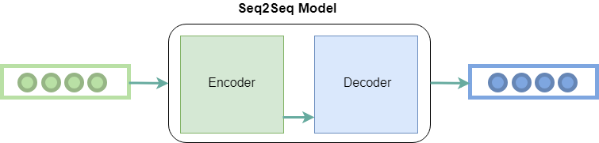

Slide 66
Encoder Block
The main purpose of the encoder block is to process the input sequence and capture information in a fixed-size context vector.
Architecture:
The input sequence is put into the encoder.
The encoder processes each element of the input sequence using neural networks (or transformer architecture).
Throughout this process, the encoder keeps an internal state, and the ultimate hidden state functions as the context vector that encapsulates a compressed representation of the entire input sequence. This context vector captures the semantic meaning and important information of the input sequence.
The final hidden state of the encoder is then passed as the context vector to the decoder.

Slide 67
Decoder Block
The decoder block is similar to encoder block. The decoder processes the context vector from encoder to generate output sequence incrementally.
Architecture:
In the training phase, the decoder receives both the context vector and the desired target output sequence (ground truth).
During inference, the decoder relies on its own previously generated outputs as inputs for subsequent steps.
The decoder uses the context vector to comprehend the input sequence and create the corresponding output sequence. It engages in autoregressive generation, producing individual elements sequentially. At each time step, the decoder uses the current hidden state, the context vector, and the previous output token to generate a probability distribution over the possible next tokens. The token with the highest probability is then chosen as the output, and the process continues until the end of the output sequence is reached.

Slide 68


The decoder and encoder architecture utilizes RNNs to generate desired outputs. Let’s look at the simplest seq2seq model.
For a given sequence of inputs , a RNN generates a sequence of outputs

Slide 69
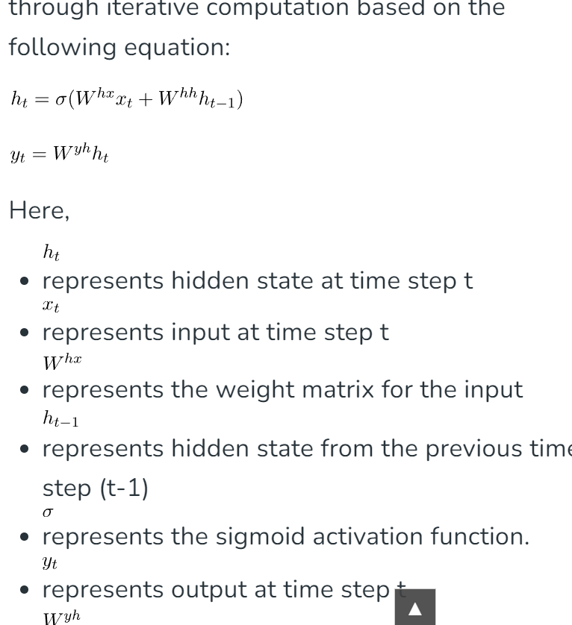


Slide 70
Recurrent Neural Networks can easily map sequences to sequences when the alignment between the inputs and the outputs are known in advance.
Although the vanilla version of RNN is rarely used, its more advanced version i.e. LSTM or GRU is used.
This is because RNN suffers from the problem of vanishing gradient.
LSTM develops the context of the word by taking 2 inputs at each point in time. One from the user and the other from its previous output, hence the name recurrent (output goes as input).

Slide 71
Advantages of seq2seq Models
Flexibility: Seq2Seq models can handle a wide range of tasks such as machine translation, text summarization, and image captioning, as well as variable-length input and output sequences.
Handling Sequential Data: Seq2Seq models are well-suited for tasks that involve sequential data such as natural language, speech, and time series data.
Handling Context: The encoder-decoder architecture of Seq2Seq models allows the model to capture the context of the input sequence and use it to generate the output sequence.

Slide 72
Attention Mechanism: Using attention mechanisms allows the model to focus on specific parts of the input sequence when generating the output, which can improve performance for long input sequences.

Slide 73
Disadvantages of seq2seq Models
Computationally Expensive: Seq2Seq models require significant computational resources to train and can be difficult to optimize.
Limited Interpretability: The internal workings of Seq2Seq models can be difficult to interpret, which can make it challenging to understand why the model is making certain decisions.
Overfitting: Seq2Seq models can overfit the training data if they are not properly regularized, which can lead to poor performance on new data.

Slide 74
Handling Rare Words: Seq2Seq models can have difficulty handling rare words that are not present in the training data.
Handling Long input Sequences: Seq2Seq models can have difficulty handling input sequences that are very long, as the context vector may not be able to capture all the information in the input sequence.

Slide 75
Applications of Seq2Seq model
Text Summarization: The seq2seq model effectively understands the input text which makes it suitable for news and document summarization.
Speech Recognition: Seq2Seq model, especially those with attention mechanisms, excel in processing audio waveform for ASR. They are able to capture spoken language patterns effectively.
Image Captioning: The seq2seq model integrate image features from CNNs with textual generation capabilities for image captioning. They are capable to describe images in a human readable format.

Slide 76
Long short-term memory (LSTM)
Self study

